Slide 1
Congregational Vitality Presbytery of South Dakota Part One
Chip Hardwick 10/25/19

Slide 2
Who are you?

Slide 5
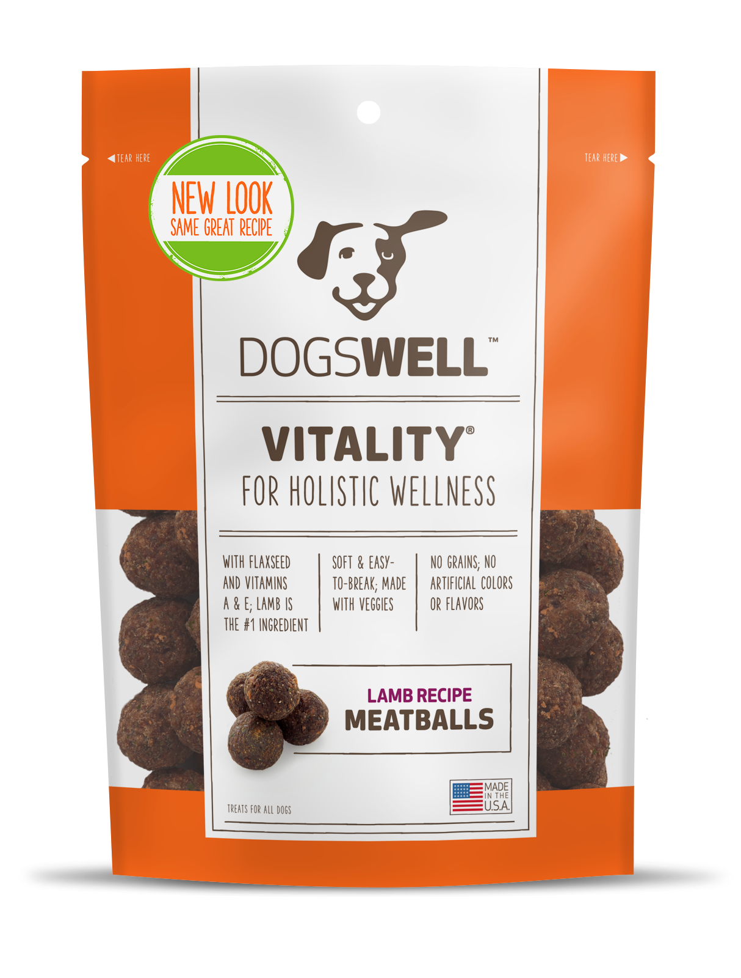
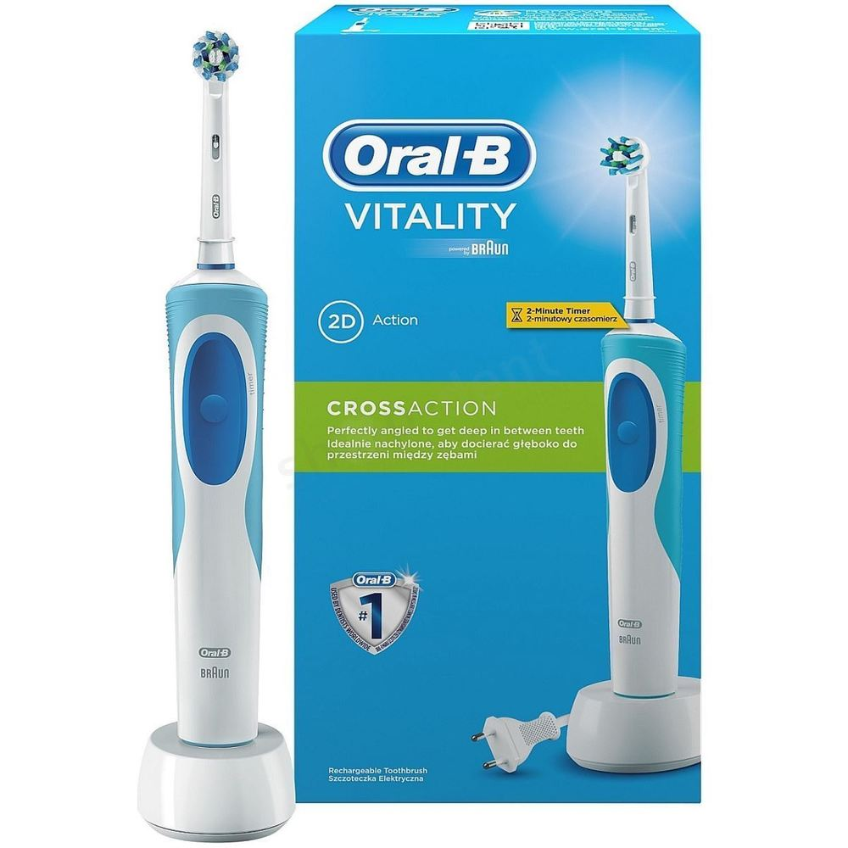
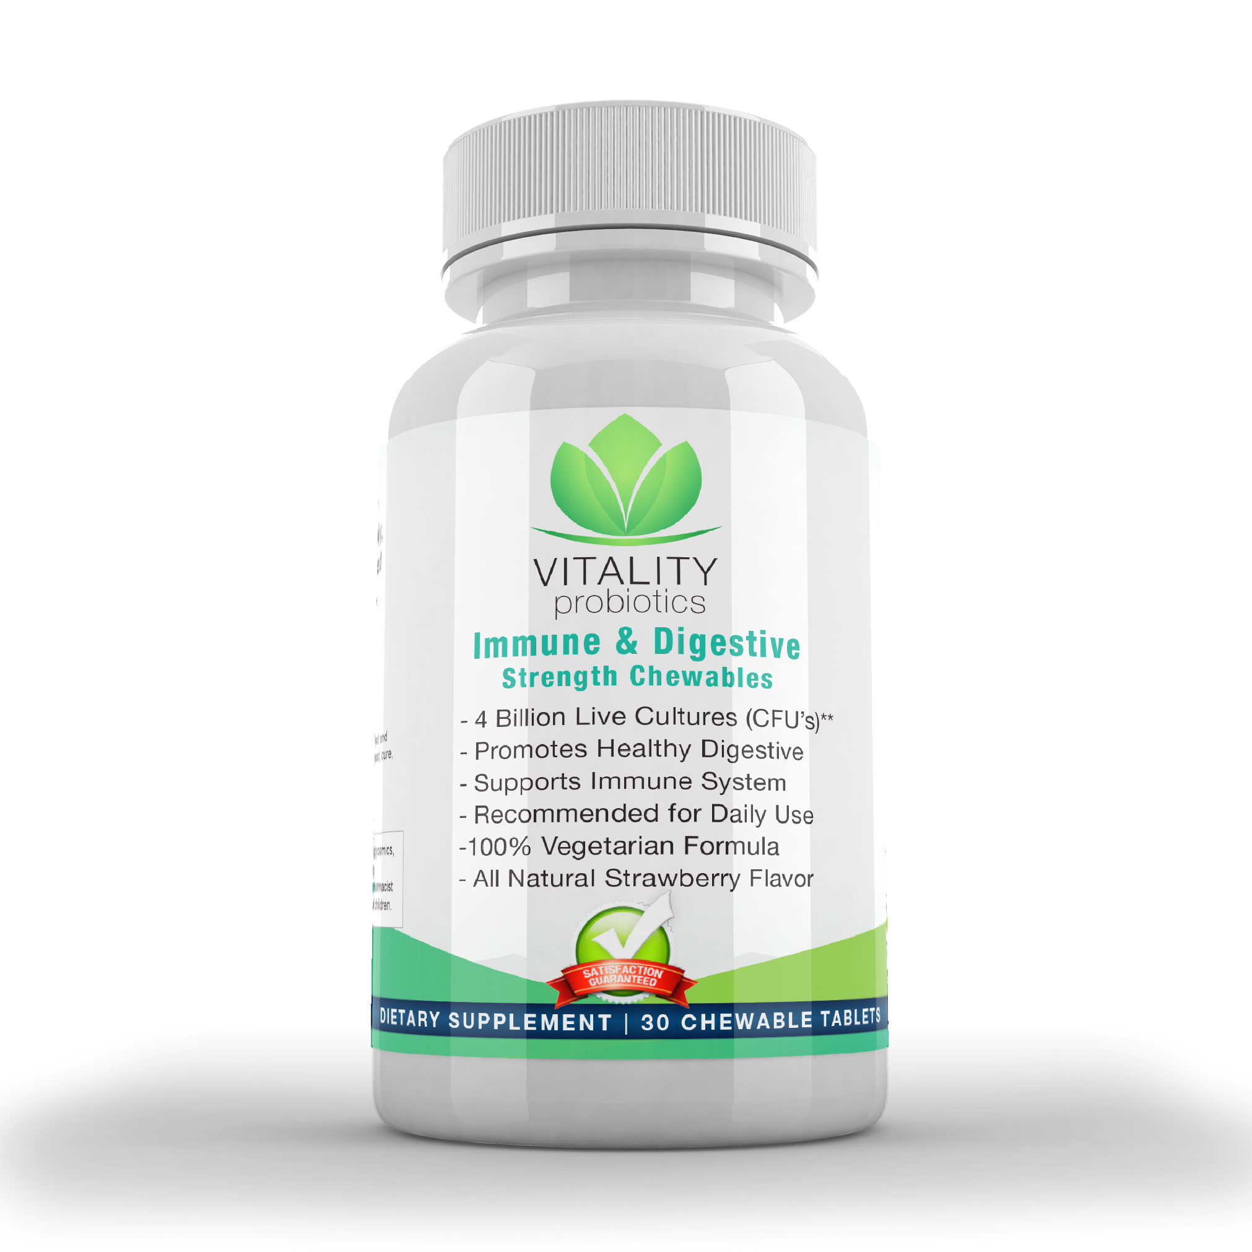

Slide 7
Overview
Part One: Faithfulness and Sustainability
Part Two: Life Cycle of a Congregation

Slide 9
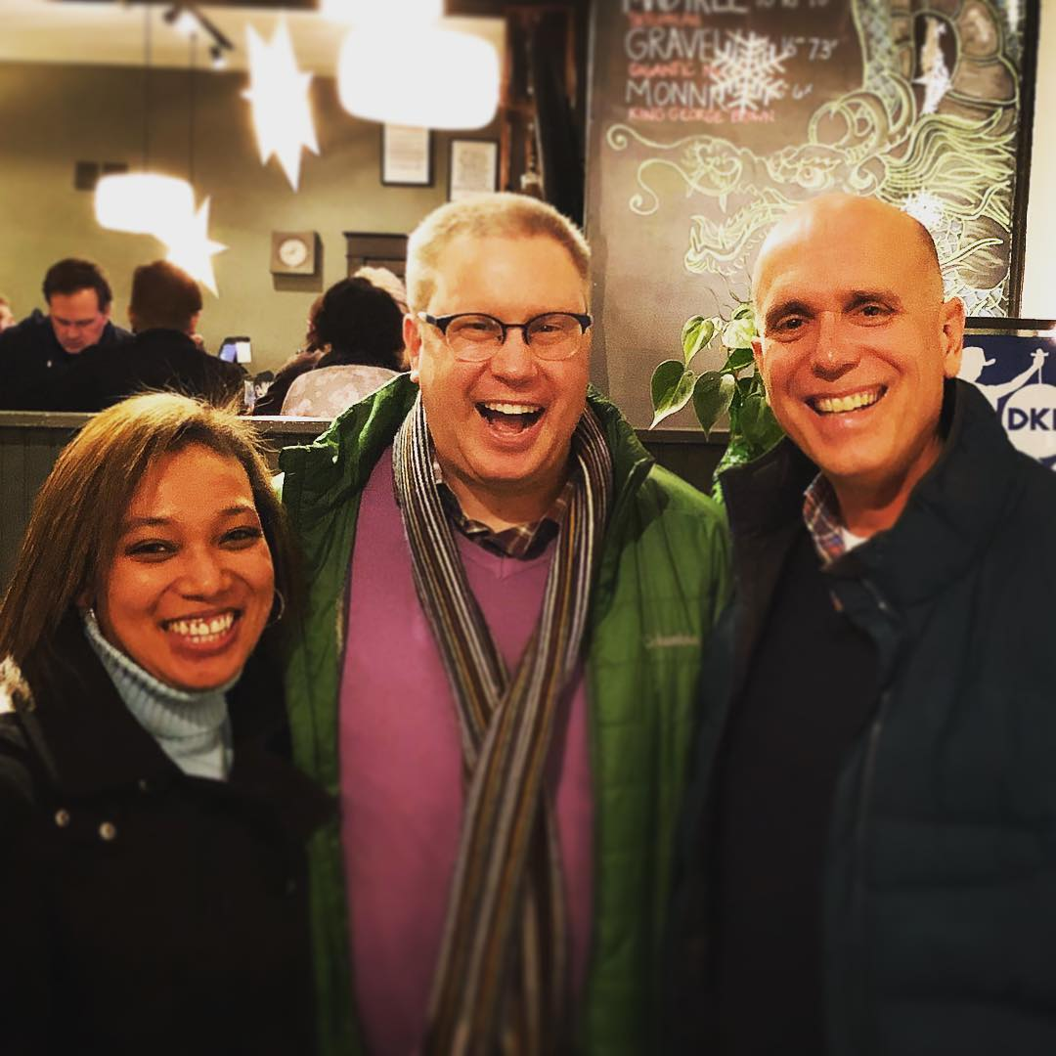
Ray Jones
Kathryn
Threadgill

Slide 10
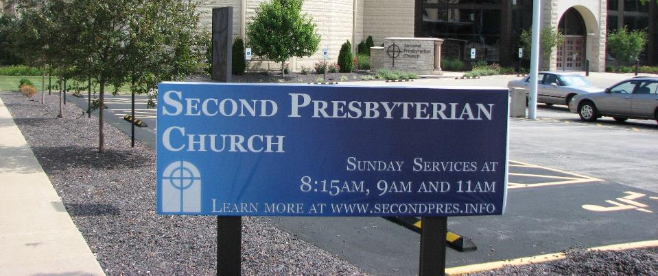

Slide 11
Is this church faithful to the Gospel?
Will this
institution
be around
in the
future?

Slide 14
Lifelong Discipleship Formation
…not head knowledge or good morals

Slide 15
Intentional Authentic Evangelism
…Not a committee, not programmatic, not church growth

Slide 16
Outward Incarnational Focus
…not inward institutional survival
or closed communities of exclusion

Slide 17
Empowering Servant Leadership
…not “the pastor’s job,” monopolized leadership, or hiring the young energetic pastor

Slide 18
Spirit-Inspired Worship
…not self-gratifying, or a stale ritual devoid of meaning, or consumer entertainment

Slide 19
Caring Relationships
…not just another social club, or facades, or hypocrisy, or judgmentalism

Slide 20
Ecclesial Health
… not unhealthy dysfunction, toxic environments, obsolete and irrelevant buildings

Slide 22
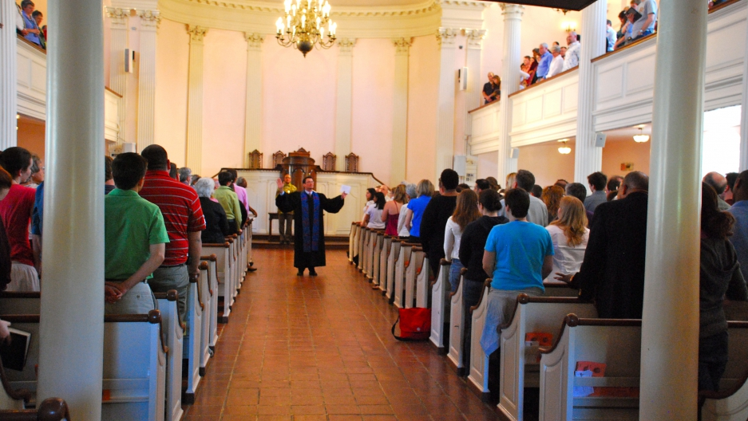
Worship Attendance (of critical mass)

Slide 23
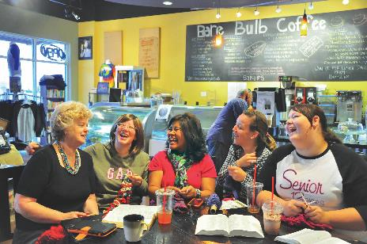
Adequate Facilities

Slide 24
Sufficient Finances

Slide 25
Dedicated Staff/Leaders

Slide 28
Discussion Questions
How are faithfulness and sustainability related?
Does one tend to come sooner than the other in a congregation?
Which should be the priority?

Slide 29
Discussion Questions
Does your Session tend to focus more on issues of faithfulness or sustainability?
Give an example of one of each that your Session has discussed recently.

Slide 30
Discussion Questions
Is it easier to work with your congregation on faithfulness or on sustainability?

