Slide 1
Congregational Vitality Presbytery of South Dakota Part Two
Chip Hardwick 10/25/19

Slide 3
Overview
Part One: Faithfulness and Sustainability
Part Two: Life Cycle of a Congregation

Slide 5
Deb Coe
PCUSA Research
Services

Slide 7
.
.
.
.
line of faithfulness
Notes:
Whether a worshiping community has the potential to be sustainable is important, but by itself it’s not enough to measure a worshiping community’s health.
Suppose you have a worshiping community that has a large endowment, and 100% of their operating expenses are paid out of that endowment every year. Furthermore, in this hypothetical community, the endowment was so large, they are living off the interest, so that the funds will remain for many, many years before it starts to dwindle. Perhaps this worshiping community once was very engaged in mission and ministry, but over time, it has become complacent. Pledges are no longer a big concern, no stewardship education is happening, and the long-time members, who fear losing the funds during their own lifetimes become less and less likely to approve any expenditures needed to start new ministries. Such a community can sustain itself for a very long time, without really feeling alive, or really fulfilling its purpose.
Therefore, we also need to be measuring something else besides sustainability ---- something like spiritual health (which for our purposes right now, we’re going to call “vitality.” We might change the terminology later to something else).
If a worshiping community is spiritually vital, then you can imagine it feels like a lively place. People really want to be there. Worship feels alive and there’s a palpable feeling of vibrancy. Ministry and mission are important to the life of this community. (CLICK to make line of vitality appear). We draw the line of vitality as a vertical axis, so that the more vital a worshiping community is, the farther to the left it appears on the graph (CLICK to make first dot appear). And conversely, the farther to the right the dot appears on the graph, the less vital it is. So, a highly vital worshiping community will be farther to the left; a worshiping community like the one we just described (endowed but feels lifeless) will be farther to the right; in the middle would be one that is spiritually “so-so.” Not really vibrant, but not dying.
NOTE that “left and right” here have NOTHING to do with politics!!!! Right now, we’re showing you this model, piece by piece --- like a puzzle. When we put these pieces together, the rationale for showing the more vital communities on the left side of the graph will make more sense!

Slide 8
Signs of Sustainability
.
.
line of sustainability
.
.
Notes:
To determine the health of a worshiping community, we need to give it a check-up, just as a physician would do in an annual physical. To assess worshiping community health, one of the things we need to assess is how well it is able to maintain itself financially. That is: is the ministry sustainable?
There are a few ways we can measure that, and because this measurement tool is still in the early stages of development, we really are open to suggestions.
(Yes, this is going to sound like it’s all about money, but bear with us for a few minutes, because after we discuss sustainability, we’ll move on to how well the worshiping community is living faithfully into its sense of call/mission/purpose. We will spend more time on that than we do on this!)
Financial health (CLICK to make first bullet point appear)
Does the worshiping community have enough annual income to meet its annual costs? This could come in the form of pledges, general offerings, and/or an endowment fund. Money from grants would not be included here, because grants are short-term.
Does the worshiping community have a realistic budget for its size (that is --- for the number of people who regularly participate)?
Is the worshiping community in debt? If so, are they in a position to repay it? How long do they expect to be repaying the debt?
Is the worshiping community relying on grants and other temporary income for its regular expenses?
Facilities (CLICK to make second bullet point appear)
Does the worshiping community have a building to maintain?
If so, is the size and age of the building appropriate for the size of the worshiping community?
Does it require a great deal of expensive maintenance, and if so, can the worshiping community realistically afford that?
If the worshiping community does not have a building, where does it meet, and what are the costs involved? Are they realistic for the size and budget of the worshiping community?
Will the worshiping community outgrow the space in the near future, requiring either a move or an addition? If so, will the associated financial burden be manageable given the current size and assets of the worshiping community?
Leadership (CLICK to make third bullet point appear)
Does the worshiping community employ paid staff, and if so, what proportion of the budget is used for salaries and benefits?
Is the leader employed full-time, or part-time; if part-time, is the worshiping community small enough that this is reasonable?
If it’s a larger worshiping community, is it adequately staffed for its size, and if so, is it able to pay its staff adequately?
Is there a leader-related conflict that is threatening to divide the worshiping community? If so, has the worshiping community been receiving help with the conflict?
By examining these factors, we can assess how likely it is that a worshiping community can sustain its ministry over a prolonged period of time in its current state, and assign it a numeric value for each of these three factors, and then an overall numeric value for sustainability.
Then, we could theoretically place it on a graph (CLICK to bring up line of sustainability), so that if it scores high on sustainability, it would appear as a dot on the graph above this line (CLICK to make first dot appear); if it scores low, it would appear as a dot below this line (CLICK to make second dot appear). The higher the score, the higher it would appear on the graph; the lower the score, the lower it would appear on the graph.

Slide 9
line of faithfulness
Sustainable
High Sustainability/
High Faithfulness
High Sustainability/
Low Faithfulness
Not sustainable
Low Sustainability/
High Faithfulness
Low Sustainability/
Low Faithfulness
line of sustain-ability
Faithful
Not Faithful
Notes:
So, now we have a two-by two grid into which we can plot a worshiping community, based on their overall score on sustainability and their overall score on spiritual vitality (if screen is blank, CLICK to show both axes).
The two axes together produce four quadrants.
In the upper left quadrant, we would plot worshiping communities with high sustainability and high spiritual vitality (CLICK to illustrate).
In the lower right quadrant, we would plot worshiping communities with low sustainability and low spiritual vitality (CLICK to illustrate).
In the lower left quadrant, we would plot worshiping communities with low sustainability but high spiritual vitality (CLICK to illustrate).
Finally, in the upper right quadrant, we would plot worshiping communities with high sustainability but low spiritual vitality (CLICK to illustrate).
(If time permits, solicit suggestions from audience about what a worshiping community might be like in each of the four quadrants); if times does not permit, give the following examples:
High Sustainability (S) + High Spiritual Vitality (SV): Most of these things are happening: people of all ages are aware of and are using their spiritual gifts, where regular Bible study happens at all ages, where a culture of generosity is present, and where good stewardship is practiced, where there is a great sense of collaboration between staff and participants, where minor conflicts don’t blow up into major ones, where there is a clearly stated mission/purpose that most can articulate, a sense of excitement and shared ownership around the mission, a focus on going out into the streets and being the hands and feet of Jesus to relieve suffering and bring justice into the world, where everyone believes that evangelism is a way of life and everyone is welcomed, where leaders are servants and leadership is taught and nurtured, where excellent preaching and lively worship is happening, and where people genuinely care about and for one another. There is a fair system of evaluating ministries, programs, and staff performance, a fair system of compensation, a clear budgeting process, and transparency about where monies come from and how they are spent. The worshiping community is able to live within its means and has a sustainable budget. It is growing enough to replace natural losses as some people move away or leave.
Low S and Low SV: Most of these things are happening: the worshiping community has been in a significant decline for a long time. It has lost its spiritual energy. There’s a sense that most participants know they need help, but either they’ve gotten help that failed, or there is some obstacle to getting help. Perhaps one person or one family controls finances, or programming, or internal politics. Worship has lost its vibrancy. Programs that once were important are no longer happening or are not happening with much energy. It has lost a good proportion of its original participants over time. An older building may be too large for the size of the group worshiping there and may have become a financial burden. There may be unresolved conflicts that continue to prevent the worshiping community from changing. When someone tries to start new ministries, they encounter obstacles. People feel frustrated, and wonder why they stay here. Losses each year outnumber newcomers, and there is a trend of budget declines as well.
Low S and High SV: This may be a newer worshiping community with lots of energy and a focus on outreach and welcoming new participants. It may have a very clear mission statement concerning its purpose and who it is trying to reach. Worship is lively and full of energy. There is a strong sense of hope. It is in a high-growth stage. It may not yet have worked out all the details about how it is to sustain itself. It may not meet in a church building, and it may not meet in the same place on a weekly basis. Space may have become a concern as the community is outgrowing its current facilities. Or it may be an older community that has gone through an extensive rebirthing process, into something new. Like a new worshiping community, there is a strong sense of hope and energy, and it is focusing on ministry and worship rather than on maintenance or self preservation.
High S and Low SV: This may be an older worshiping community that up until recently was both sustainable and spiritually vital. But it has plateaued; growth has stopped. It may be going through a process of redefining the vision, which could quickly put it back into the High Sustainability and High Spiritual Vitality quadrant. It probably is not mired in deep conflict, or if it is, the conflict is recent. Or, it would be in the Low Sustainability and Low Spiritual Vitality quadrant, except that a large endowment has allowed this worshiping community to continue on without asking much of its participants.

Slide 10
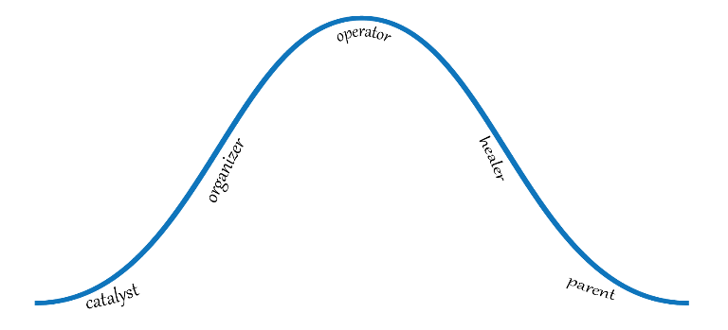
Typical Life Cycle Model for Worshiping Communities
Sustainable
Quadrant 2
Quadrant 3
Not sustainable
Quadrant 1
Quadrant 4
Faithful
Not Faithful
Notes:
The life cycle of a worshiping community: this is a diagram of a typical life cycle model that you might find in any book on congregational vitality. Here, we’ve overlaid it over the four-quadrant grid that we’ve just gone through.
You’d start with the lower left (quadrant 1) (CLICK to have Quadrant 1 title appear on graph), and follow the blue line (here, you are plotting two scores: spiritual vitality and sustainability, just like you would plot X,Y variables on a graph when you were back in high school math).
These are the high spiritual-vitality worshiping communities that are not yet sustainable. They are either new or newer, or are an older community that has reinvented itself into something new.
Remember: the more highly spiritually vital a worshiping community is, the farther left it appears on the graph. Because we are moving from left to right through the life cycle, this is why we said that communities to the left of the line of vitality would be more vital. As you follow the blue line through Quadrant 1, the natural progression of a new or renewed worshiping community is to grow, and with that growth comes resources that lead to higher sustainability. So, as it becomes more sustainable, it’s moving upward into Quadrant 2. But also notice that it’s also moving to the right as it moves up. It’s losing some spiritual momentum. Those in Quadrant 1 are therefore the fastest growing worshiping communities.
What kinds of leaders are typically found in a Quadrant 1 worshiping community? Those who are natural catalysts; they know how to get things started, have great entrepreneurial skills. As they grow and move into sustainability (which moves them up into Quadrant 2 (CLICK to have Quadrant 2 title appear on graph), that person also needs to be a great organizer, or needs to have an organizer join the team, or needs to be replaced by a great organizer.
Worshiping communities located within Quadrant 2 are the most spiritually vital and the most sustainable. It’s where most worshiping communities want to be. What kinds of leaders tend to lead Quadrant 2 communities? Those with great organizational and administrative skills, as well as those who are good general operators; they know how to keep things running smoothly.
However, absent of other skills, or a tendency toward creativity and innovation, an operator leader type also tends toward leadership that feels “safe” and “responsible,” and one side effect of that can be a loss of energy and enthusiasm for ministry, as the worshiping community becomes set in their ways and resistant to changes and new ideas (which unfortunately tend to pop up when new leaders emerge!). So, an operator type can also help push a worshiping community over the hump and into Quadrant 3 (CLICK to have Quadrant 3 title appear on graph), where it might plateau for a while and then begin a slow decline in spiritual vitality and in sustainability.
Leaders in Quadrant 3 tend to be operators and at some point tend to be replaced by healers, who hope to help the worshiping community redefine its purpose in efforts to return to Quadrant 2. Healers are usually hired to provide pastoral care in conflicted, declining worshiping communities. Unfortunately, what is needed to turn the community around is a catalyst/innovator type, but usually by the time the worshiping community moves low into Quadrant 3 or into Quadrant 4, they WANT a healer to make them feel well again as a community, despite what the overall community needs.
Leaders in Quadrant 4 (CLICK to have Quadrant 4 title appear on the graph) tend to be healers (thinking of themselves as chaplains more than as agents for change) and as the worshiping community slides further into decline, they often want, and get, a “parent” leader; someone who fills in the leadership vacuum that has slowly built up through the decline.
What is missing in this model, though, is what happens when a worshiping community moves along into Quadrant 3 or 4 and does some redefinition or redevelopment. Let’s talk about that next.

Slide 11
Typical Life Cycle Model for Worshiping Communities
Sustainable
Declining
Thriving
Not sustainable
Growing
Struggling
Faithful
Not Faithful
Notes:
The life cycle of a worshiping community: this is a diagram of a typical life cycle model that you might find in any book on congregational vitality. Here, we’ve overlaid it over the four-quadrant grid that we’ve just gone through.
You’d start with the lower left (quadrant 1) (CLICK to have Quadrant 1 title appear on graph), and follow the blue line (here, you are plotting two scores: spiritual vitality and sustainability, just like you would plot X,Y variables on a graph when you were back in high school math).
These are the high spiritual-vitality worshiping communities that are not yet sustainable. They are either new or newer, or are an older community that has reinvented itself into something new.
Remember: the more highly spiritually vital a worshiping community is, the farther left it appears on the graph. Because we are moving from left to right through the life cycle, this is why we said that communities to the left of the line of vitality would be more vital. As you follow the blue line through Quadrant 1, the natural progression of a new or renewed worshiping community is to grow, and with that growth comes resources that lead to higher sustainability. So, as it becomes more sustainable, it’s moving upward into Quadrant 2. But also notice that it’s also moving to the right as it moves up. It’s losing some spiritual momentum. Those in Quadrant 1 are therefore the fastest growing worshiping communities.
What kinds of leaders are typically found in a Quadrant 1 worshiping community? Those who are natural catalysts; they know how to get things started, have great entrepreneurial skills. As they grow and move into sustainability (which moves them up into Quadrant 2 (CLICK to have Quadrant 2 title appear on graph), that person also needs to be a great organizer, or needs to have an organizer join the team, or needs to be replaced by a great organizer.
Worshiping communities located within Quadrant 2 are the most spiritually vital and the most sustainable. It’s where most worshiping communities want to be. What kinds of leaders tend to lead Quadrant 2 communities? Those with great organizational and administrative skills, as well as those who are good general operators; they know how to keep things running smoothly.
However, absent of other skills, or a tendency toward creativity and innovation, an operator leader type also tends toward leadership that feels “safe” and “responsible,” and one side effect of that can be a loss of energy and enthusiasm for ministry, as the worshiping community becomes set in their ways and resistant to changes and new ideas (which unfortunately tend to pop up when new leaders emerge!). So, an operator type can also help push a worshiping community over the hump and into Quadrant 3 (CLICK to have Quadrant 3 title appear on graph), where it might plateau for a while and then begin a slow decline in spiritual vitality and in sustainability.
Leaders in Quadrant 3 tend to be operators and at some point tend to be replaced by healers, who hope to help the worshiping community redefine its purpose in efforts to return to Quadrant 2. Healers are usually hired to provide pastoral care in conflicted, declining worshiping communities. Unfortunately, what is needed to turn the community around is a catalyst/innovator type, but usually by the time the worshiping community moves low into Quadrant 3 or into Quadrant 4, they WANT a healer to make them feel well again as a community, despite what the overall community needs.
Leaders in Quadrant 4 (CLICK to have Quadrant 4 title appear on the graph) tend to be healers (thinking of themselves as chaplains more than as agents for change) and as the worshiping community slides further into decline, they often want, and get, a “parent” leader; someone who fills in the leadership vacuum that has slowly built up through the decline.
What is missing in this model, though, is what happens when a worshiping community moves along into Quadrant 3 or 4 and does some redefinition or redevelopment. Let’s talk about that next.

Slide 12
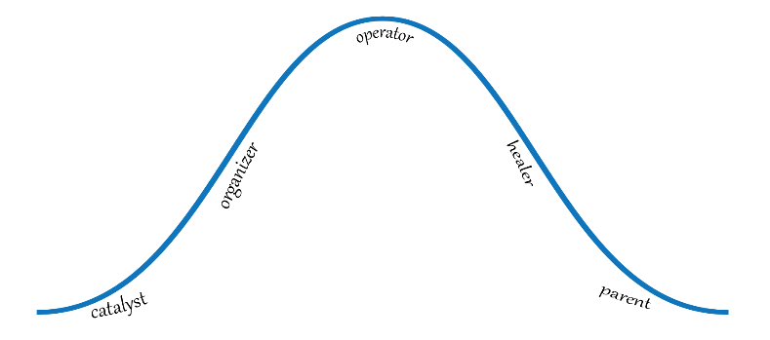
Redefinition: From Declining to Thriving
Sustainable
Thriving
Declining
Not Sustainable
Faithful
Not Faithful
Notes:
Let’s say a worshiping community crosses the line from Quadrant 2 (CLICK to show Quadrant 2 title), which is highly spiritually vital and highly sustainable, into Quadrant 3, which is a little less spiritually vital but still sustainable (CLICK to show Quadrant 3 title).
Remember, the trajectory is the blue curved line, so that initially, a Quadrant 3 community would still be fairly high in spiritual vitality (as far left as you can go in Quadrant 3, and still pretty high in sustainability (as high as you can go, but starting to go downhill just a bit).
IF this community does some work to redefine its goals/direction, it can easily work its way back to Quadrant 2 (CLICK to show green “redefinition” circle). NOTE that doing so requires a leader who is more of an innovator than an operator. If not the worshiping community leader, than perhaps a volunteer team that is led by an innovator can make it happen.

Slide 13
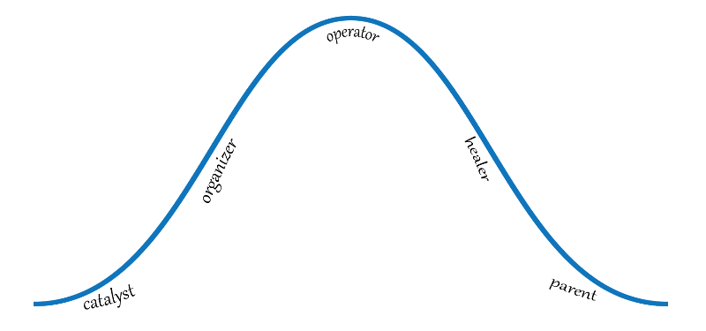
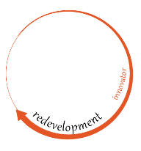
Redevelopment: From Declining to Growing or Thriving
Sustainable
Thriving
Declining
Not Sustainable
Growing
Faithful
Not Faithful
Notes:
But what if the worshiping community has moved a bit farther along the blue line, deeper into Quadrant 3, and has lost so much of its momentum that it seems stuck, it’s losing people, losing income, losing energy?
In such a case, simple redefinition of the worshiping community’s mission might not be enough; it might need redevelopment (CLICK to show red “redevelopment” circle). This is when it’s helpful to bring in the presbytery and possibly also a consultant who is trained in redevelopment. A careful assessment of the worshiping community’s history is useful toward understanding how it got into this state and what is needed to do some redevelopment.
Notice that the red redevelopment circle is a bit broader than the green redefinition circle, because it represents a worshiping community that has moved farther along the blue line into Quadrant 3 and when it returns to a Quadrant 2 state, depending on its individual circumstances, it might barely qualify as a Quadrant 2 worshiping community (might not be sustainable at first; spiritual vitality is lower --- to the right of the blue line, which is the “ideal”).
Once again, the work of an innovator is needed for this redevelopment to happen, and usually, worshiping communities in this state don’t have an innovative leader; they have an operator or a healer. So, some sort of intervention might be needed, or, if the leader is genuinely willing to see the redevelopment happen, an innovator might be able to come alongside the leader to help them through the process. However, in order for the worshiping community to become very spiritually vital and very sustainable, the leadership ought to be equipped to deal with change, because big changes will be needed.

Slide 14
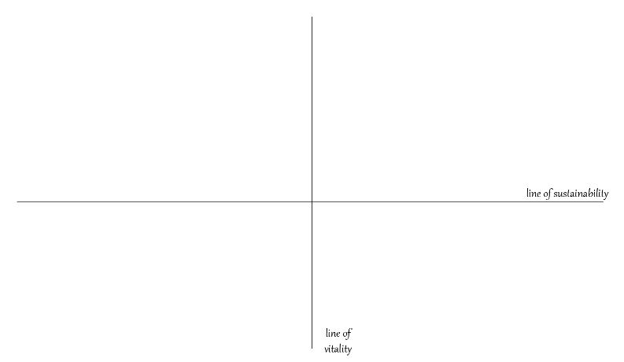
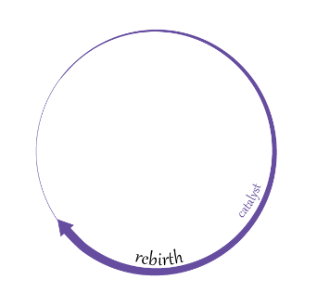
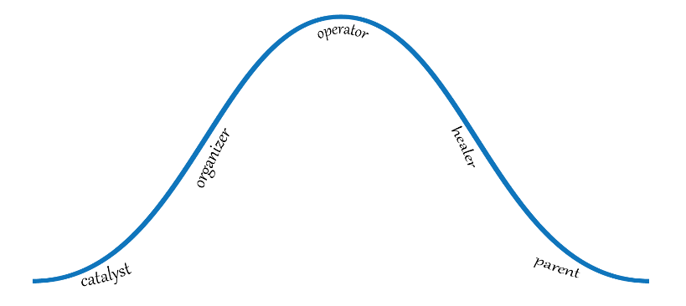
Rebirth: From Struggling to Growing
Sustainable
Thriving
Declining
Not sustainable
Growing
Struggling
Faithful
Not Faithful
Notes:
When a Quadrant 4 worshiping community finds some help, it’s not enough to redefine its mission, or redefine itself. Even redevelopment may not be possible; what’s needed is a whole new identity as something completely different than its former self: a rebirth (CLICK to show purple “rebirth” circle).
Rebirth requires a catalyst; the type of leader needed for new worshiping communities; someone who is entrepreneurial and able to start something new. This kind of a shift is the most difficult, painful, and least likely to be successful, because it requires saying goodbye to the “parent” leader and hello to a “catalyst” leader. It requires letting go of the past and thinking like a new worshiping community with completely different goals and focus. It is NOT the place for people who wish to return to some golden era that existed decades ago because that’s not going to happen.
But it’s possible.
The purple “rebirth” circle is broader because it represents that larger amount of change that must happen for a successful rebirthing. It shows that more work is required. And, you’ll notice that it does not return the community into Quadrant 2 and sustainability; the new worshiping community that is formed is clearly in Quadrant 1 and must work hard to achieve sustainability.

Slide 17
Question for Discussion
Where do you think your church is in its life cycle?
What leads you to that conclusion?
What are some steps to help move it toward health and vibrancy?

Slide 19
Contact Information
Dr. Chip Hardwick
First Presbyterian Church of Lake Forest
chiphardwick@gmail.com
Facebook: Chip.Hardwick.5
Twitter: @chiphardwick
Instagram @chiphardwick

